Slide 1
ECE314 Lab 10 Overview
Gaussian distribution (one-dimensional and multidimensional)
Central limit theorem
Change detection

Slide 2



Gaussian distribution (one-dimensional)
$$X∼Gaussian(μ,σ^{2})$$
pdf $p\left(x\right)= \frac{1}{\sqrt{2πσ^{2}}}e^{−\frac{{\left(x−μ\right)}^{2}}{2σ^{2}}}$
$$μ=0, σ^{2}=1$$

Slide 3
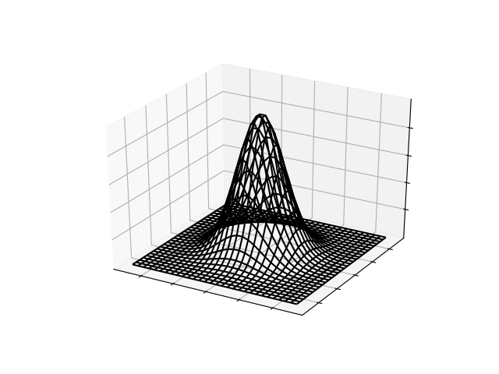









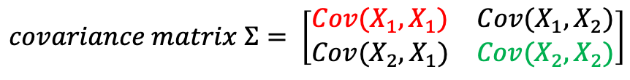


Gaussian distribution (multidimensional)
$$=Var(X_{1})$$
$$\left[\begin{matrix}X_{1} \\ X_{2}\end{matrix}\right]∼Gaussian(μ,Σ)$$
$$mean vector μ=\left[\begin{matrix}μ_{1} \\ μ_{2}\end{matrix}\right]$$
$$covariance matrix Σ= \left[\begin{matrix}Cov(X_{1},X_{1}) & Cov(X_{1},X_{2}) \\ Cov(X_{2},X_{1}) & Cov(X_{2},X_{2})\end{matrix}\right]$$
$$=Var(X_{2})$$
$$Cov\left(X_{1},X_{2}\right)=0$$
$$Cov\left(X_{1},X_{2}\right)>0$$
$$p\left(\left[\begin{matrix}x_{1} \\ x_{2}\end{matrix}\right]\right)$$
$$x_{2}$$
$$x_{2}$$
$$x_{1}$$
$$x_{1}$$

Slide 4




Binary hypothesis testing for multidimensional Gaussian distributions
$$H_{0}:X∼Gaussian(μ_{0},Σ_{0})$$
$$H_{1}:X∼Gaussian(μ_{1},Σ_{1})$$
$$x_{2}$$
$$x_{1}$$

Slide 5
Binary hypothesis testing for multidimensional Gaussian distributions
$$H_{0}:X∼Gaussian(μ_{0},Σ_{0})$$
$$H_{1}:X∼Gaussian(μ_{1},Σ_{1})$$
Observations:
Q: which hypothesis is true?
$$x_{2}$$
$$x_{1}$$

Slide 6






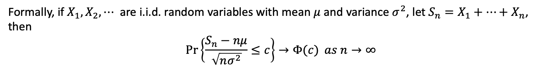

Central limit theorem
Toss a fair coin 10000 times, let $S$ be the total number of heads.
Law of Large Numbers: $S≈5000$
Central Limit Theorem: approximately $S∼Gaussian(5000, 2500)$
Less
Likely
More
Likely
More
Likely
Less
Likely
$$3000$$
$$4000$$
$$5000$$
$$6000$$
$$7000$$
Formally, if $X_{1}, X_{2}, ⋯$ are i.i.d. random variables with mean $μ$ and variance $σ^{2}$, let $S_{n}=X_{1}+⋯+X_{n}$, then
$$\operatorname{Pr}\left\{\frac{S_{n}−nμ}{\sqrt{nσ^{2}}}≤c\right\}→Φ(c) as n→∞$$
Standardized version of $S_{n}$

Slide 7

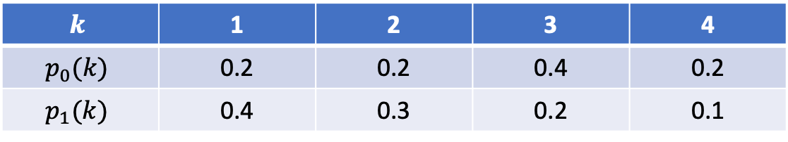


Change detection
$$k$$ | 1 | 2 | 3 | 4
$$p_{0}(k)$$ | 0.2 | 0.2 | 0.4 | 0.2
$$p_{1}(k)$$ | 0.4 | 0.3 | 0.2 | 0.1
$$H_{0}$$
$$H_{1}$$
First $H_{0}$, then changes to $H_{1}$ at some unknown time.
Goal: raise an alarm as soon as possible after the change.
time
3 4 2 1 3 3 2 3 2 4 3 1 3 2 2 1 1 1 3 2 1 1 4 2 1

Slide 8
Change detection
$$k$$ | 1 | 2 | 3 | 4
$$p_{0}(k)$$ | 0.2 | 0.2 | 0.4 | 0.2
$$p_{1}(k)$$ | 0.4 | 0.3 | 0.2 | 0.1
$$H_{0}$$
$$H_{1}$$
First $H_{0}$, then changes to $H_{1}$ at some unknown time.
Goal: raise an alarm as soon as possible after the change.
time
3 4 2 1 3 3 2 3 2 4 3 1 3 2 2 1 1 1 3 2 1 1 4 2 1

Slide 9





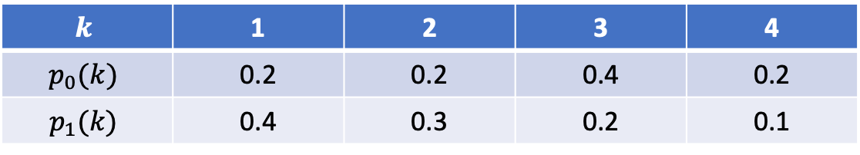


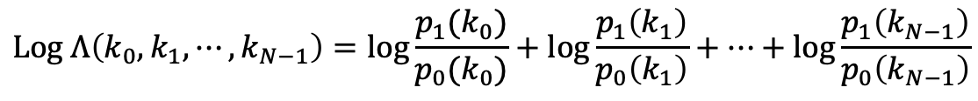






Change detection: window method
$$k$$ | 1 | 2 | 3 | 4
$$p_{0}(k)$$ | 0.2 | 0.2 | 0.4 | 0.2
$$p_{1}(k)$$ | 0.4 | 0.3 | 0.2 | 0.1
$$H_{0}$$
$$H_{1}$$
First $H_{0}$, then changes to $H_{1}$ at some unknown time.
Goal: raise an alarm as soon as possible after the change.
time
3 4 2 1 3 3 2 3 2 4 3 1 3 2 2 1 1 1 3 2 1 1 4 2 1
$$Log Λ\left(k_{0},k_{1},⋯, k_{N−1}\right)=\log{\frac{p_{1}(k_{0})}{p_{0}(k_{0})}}+\log{\frac{p_{1}\left(k_{1}\right)}{p_{0}\left(k_{1}\right)}}+⋯+\log{\frac{p_{1}\left(k_{N−1}\right)}{p_{0}\left(k_{N−1}\right)}}$$
$$Log Λ$$
threshold
change
raise alarm
$$0$$
$$W$$
$$2W$$
$$3W$$
$$4W$$
time

Slide 10
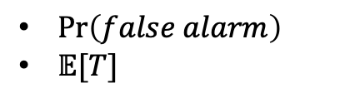


Change detection: Cumulative Sum method
$$k$$ | 1 | 2 | 3 | 4
$$p_{0}(k)$$ | 0.2 | 0.2 | 0.4 | 0.2
$$p_{1}(k)$$ | 0.4 | 0.3 | 0.2 | 0.1
$$H_{0}$$
$$H_{1}$$
First $H_{0}$, then changes to $H_{1}$ at some unknown time.
Goal: raise an alarm as soon as possible after the change.
time
3 4 2 1 3 3 2 3 2 4 3 1 3 2 2 1 1 1 3 2 1 1 4 2 1
$$Log Λ\left(k_{0},k_{1},⋯, k_{N−1}\right)=\log{\frac{p_{1}(k_{0})}{p_{0}(k_{0})}}+\log{\frac{p_{1}\left(k_{1}\right)}{p_{0}\left(k_{1}\right)}}+⋯+\log{\frac{p_{1}\left(k_{N−1}\right)}{p_{0}\left(k_{N−1}\right)}}$$
$$Log Λ$$
threshold
$\operatorname{Pr}\left(false alarm\right)$
$𝔼[T]$
raise alarm
$$0$$
change
time
$$T$$

